Slide 1
Sales Prediction Model

Slide 2
01
Introduction

Slide 3
Data Preprocessing
sales_data["state_holiday"] = sales_data["state_holiday"].astype("category").cat.codes
Convert the ‘date’ column to datetime
Extract features from the date
df['day'] = df['date'].dt.day
df['month'] = df['date'].dt.month
df['year'] = df['date'].dt.year
df["date"] = pd.to_datetime(df["date"])
sales.csv
Drop the original date column
Convert categorical values to numerical values
df.drop(columns=['date'], inplace=True)
df["state_holiday"] = df["state_holiday"].astype("category").cat.codes

Slide 4
02
Model Training & Evaluation

Slide 5
Splitting the data
80%
Training
X = df.drop(columns=["sales","index"])
y = df["sales"]
X_train, X_test, y_train, y_test = train_test_split(X, y, test_size=0.2, random_state=42)
20%
Testing

Slide 6
Models Used
01
02
03
Linear Regression
Decision Tree
KNN
04
Random Forest
05
XGBoost

Slide 7
Model Evaluation
 | Linear Regression | Decision Tree | KNN | Random Forest | XGBoost
MEAN ABSOLUTE ERROR | 987.96 | 683.68 | 839.35 | 535.57 | 676.01
MEAN SQUARED ERROR | 2187686.85 | 1419568.72 | 1729407.08 | 758321.07 | 984954.75
R2 SCORE | 0.85 | 0.90 | 0.88 | 0.95 | 0.93

Slide 8
FIND THE BEST MODEL
best_model_name = max(results, key=lambda x: results[x]["R2 SCORE"])
best_score = results[best_model_name]["R2 SCORE"]
best_model = models[best_model_name]
print(f"Best model: {best_model_name}")
print(f"Best R² Score: {best_score}")
0.85
0.90
0.88
Best model: Random Forest
Best R² Score: 0.95
0.95
0.93

Slide 9
03
Predictions & Performance Metrics

Slide 10
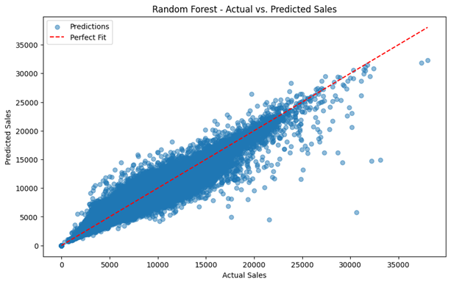
Predict on the Test Set
The best-performing model (best_model) is used to make predictions on X_test.
The predicted values are stored in y_test_pred
y_test_pred = best_model.predict(X_test)
A scatter plot is created to compare the actual sales (y_test) with the predicted sales (y_test_pred)
The points in the scatter plot represent predictions, with the x-axis as actual sales and the y-axis as predicted sales
plt.scatter(y_test, y_test_pred, alpha=0.5, label="Predictions")

Slide 11
Prepare the Real Data for Prediction
01
02
03
04
loads the real data from "REAL_DATA.csv" and displays the first few rows
Removes the "index" column to ensure the dataset is correctly formatted
Uses the best model (best_model) to predict sales (saless)
Saves the predictions in a CSV file (REAL_DATA_with_predictions.csv)
test_df = test_df.drop(columns=["index"])
X_real = test_df[X_train.columns]
test_df["saless"] = best_model.predict(X_real)
test_df.to_csv("REAL_DATA_with_predictions.csv", index=False)

Slide 12
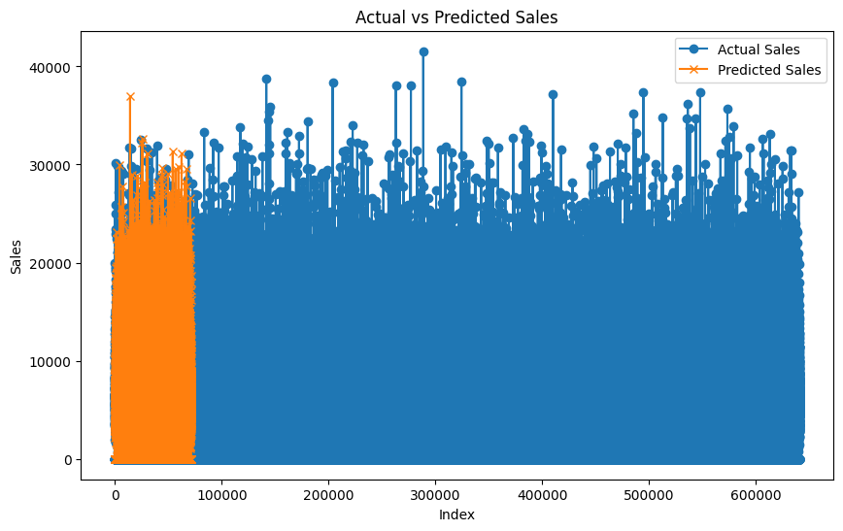
Comparing Actual Sales with Predicted Sales
comparison_df = df[["sales"]].copy()
comparison_df["saless"] = test_df["saless"]

Slide 13
Evaluating Classification Metrics
Calculates
Converts regression values into binary classes
Imports classification evaluation metrics
threshold = y_train.median()
y_test_class = (y_test > threshold).astype(int)
y_test_pred_class = (y_test_pred > threshold).astype(int)
balanced_acc = balanced_accuracy_score(y_test_class, y_test_pred_class)
recall = recall_score(y_test_class, y_test_pred_class)
f1 = f1_score(y_test_class, y_test_pred_class)
from sklearn.metrics import accuracy_score, balanced_accuracy_score, recall_score, f1_score

Slide 14
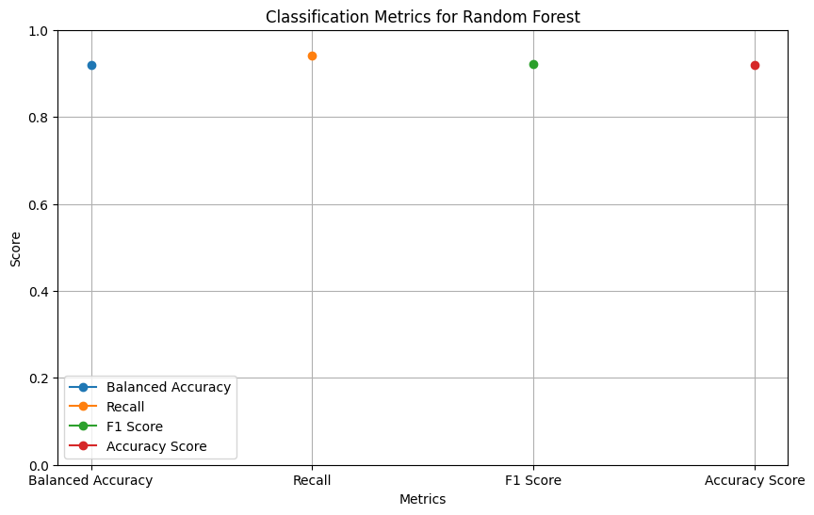
Accuracy Score: 0.8949269708507583
Balanced Accuracy Score: 0.894938381756415
Recall Score: 0.9152510617037222
F1 Score: 0.8969680277261356

Slide 15
04
Conclusion & Future Improvements

Slide 16
Our team
Dana Saeed
Ghala Al-Otaibi
ESSA RIYAD

